Slide 1
Battle of the Neighborhoods
Presented by
Mohammed Saidul Islam

Slide 2

Contents
Introduction to the Business problem
Data description
Methodology used
Analysis on the data
Results and Discussion
Conclusion

Slide 3

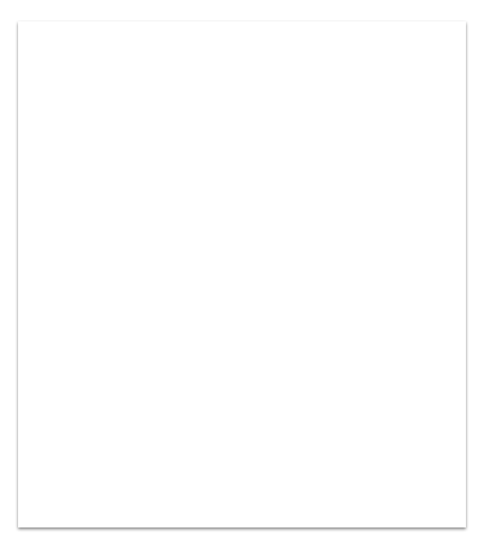
Intro to the Business problem
The business problem revolves around a person who wants to open a coffee shop in the city of vaughan in canada.
Internal stakeholder The owner himself/herself
External stakeholder The customers/consumers in the neighborhoods

Slide 4
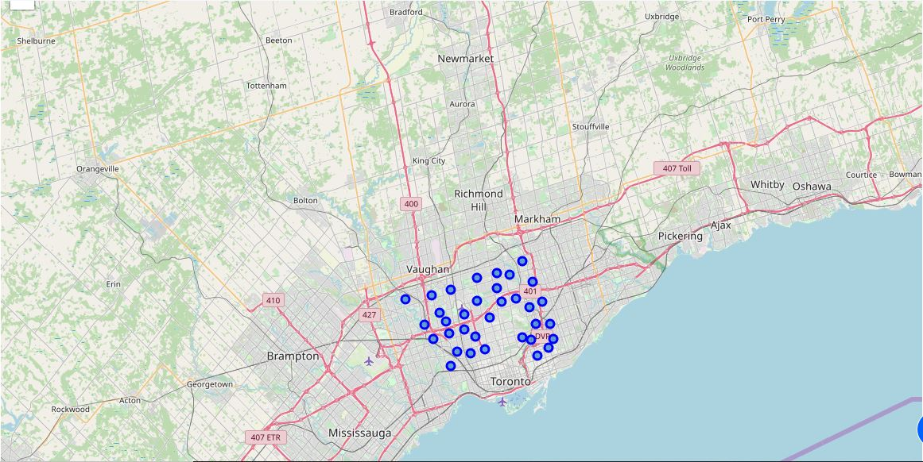
Data Description:
Dataset 1: Canada postal code https://en.wikipedia.org/wiki/List_of_postal_codes_of_Canada:_M
This dataset consists of three columns
PostalCode
Borough
Neighborhood
Dataset 2: Longitude, Latitude values of the neighborhoods
http://cocl.us/Geospatial_data
Venues of the neighborhoods are collected using Foursquare API
Data extraction
Data from the webpage scraped by using “Beautifulsoup4”

Slide 5
Methodology used
Boroughs North York, East York and York
Foursquare API Foursquare API has been used to find out the venues in the neighborhoods
Filtering neighborhoods
Neighborhoods were filtered based on the absence of coffee shops
Clustering
Clustering technique (k-means clustering) used to cluster similar neighborhoods

Slide 6
Analysis on the data
One-hot encoding Neighborhood venues are one-hot encoded and then grouped by their mean values
Top 5 venues Top 5 venues were found in each neighborhoods
Sorting venues
Venues were then sorted based on their frequency values
Clustering
Using k-means clustering to find 5 clusters of neighborhoods

Slide 7
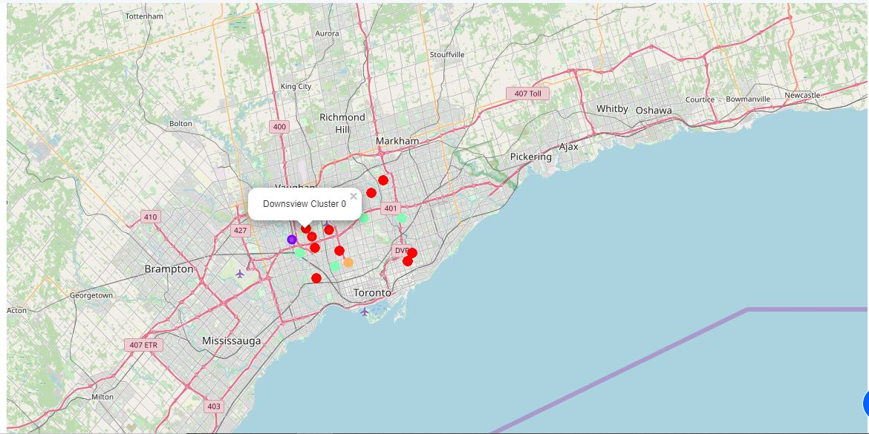
Results and Discussion:
Number of clusters found: 5
Potential clusters with business prospects are: Cluster 0 and Cluster 3
Among them the neighborhood named “Downsview” in cluster 0 would be most suitable for that person to open up a coffee shop
The intra cluster distance of the neighborhoods in cluster 0 is less compared to other clusters.
And Downsview neighborhood is much close to its neighboring neighborhood.
This is why it would be much suitable.
Cluster 0
Neighborhoods: ’Parkview Hill / Woodbine Gardens’, ’Glencairn’,
’Woodbine Heights’, ’Hillcrest Village’, ’Bayview Village’, ’Downsview’, ’North Park / Maple
Leaf Park / Upwood Park’, ’Runnymede / The Junction North’

Slide 8
Conclusion
In conclusion, it can be said that there much room to improve to find prospective neighborhood to open a new business as there were lack of some data, like population density, user behavior of the neighborhoods.
But , based on the dataset the result found is sufficient and can be said confidently that the neighborhood “Downsview” has higher prospect than other neighborhoods.

Slide 9
Thank you!

